Slide 1


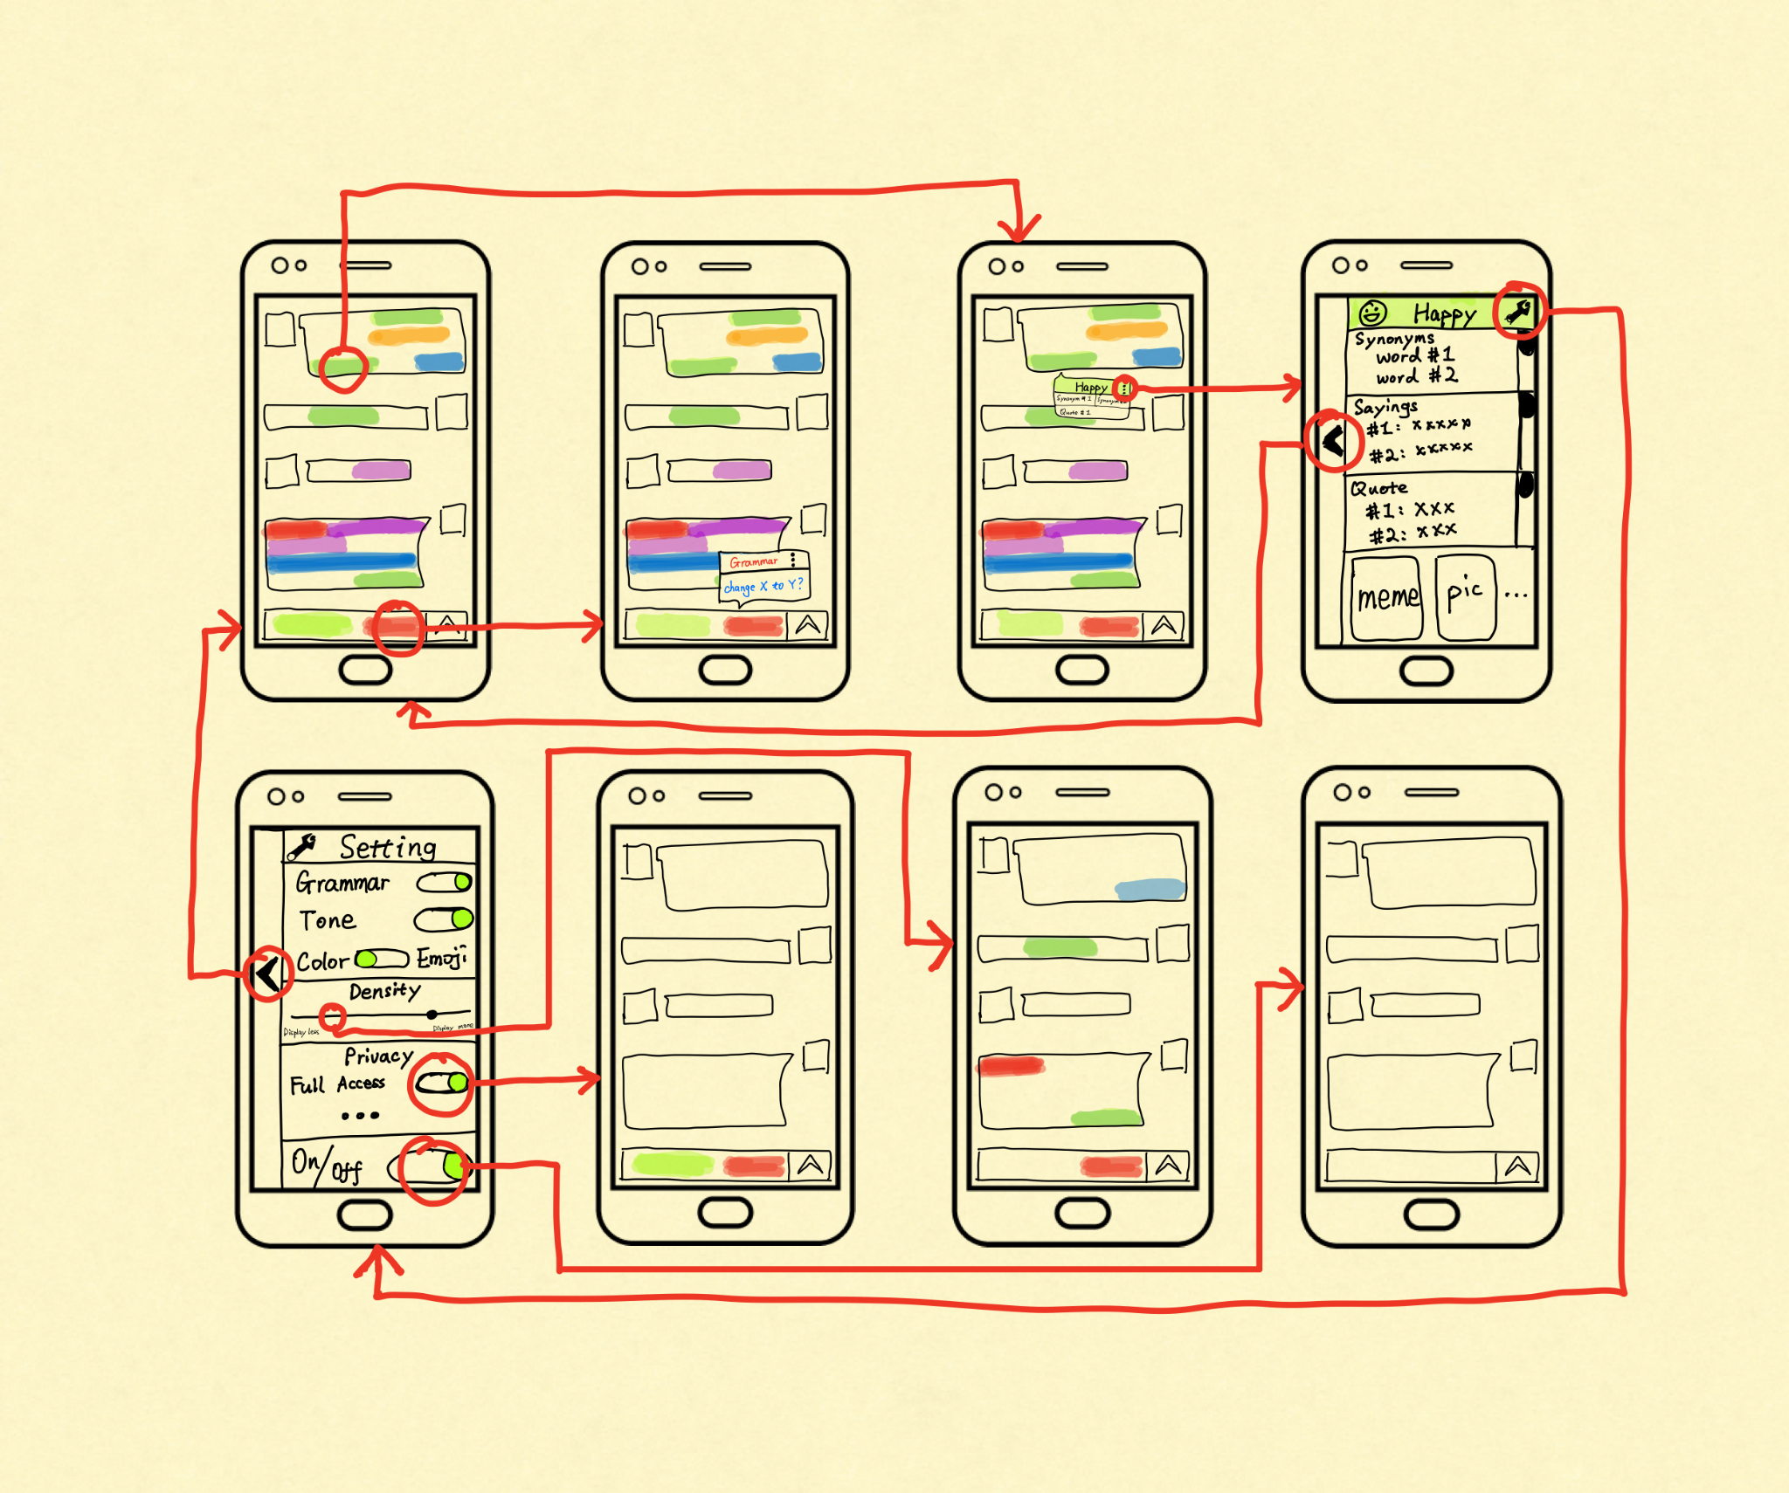
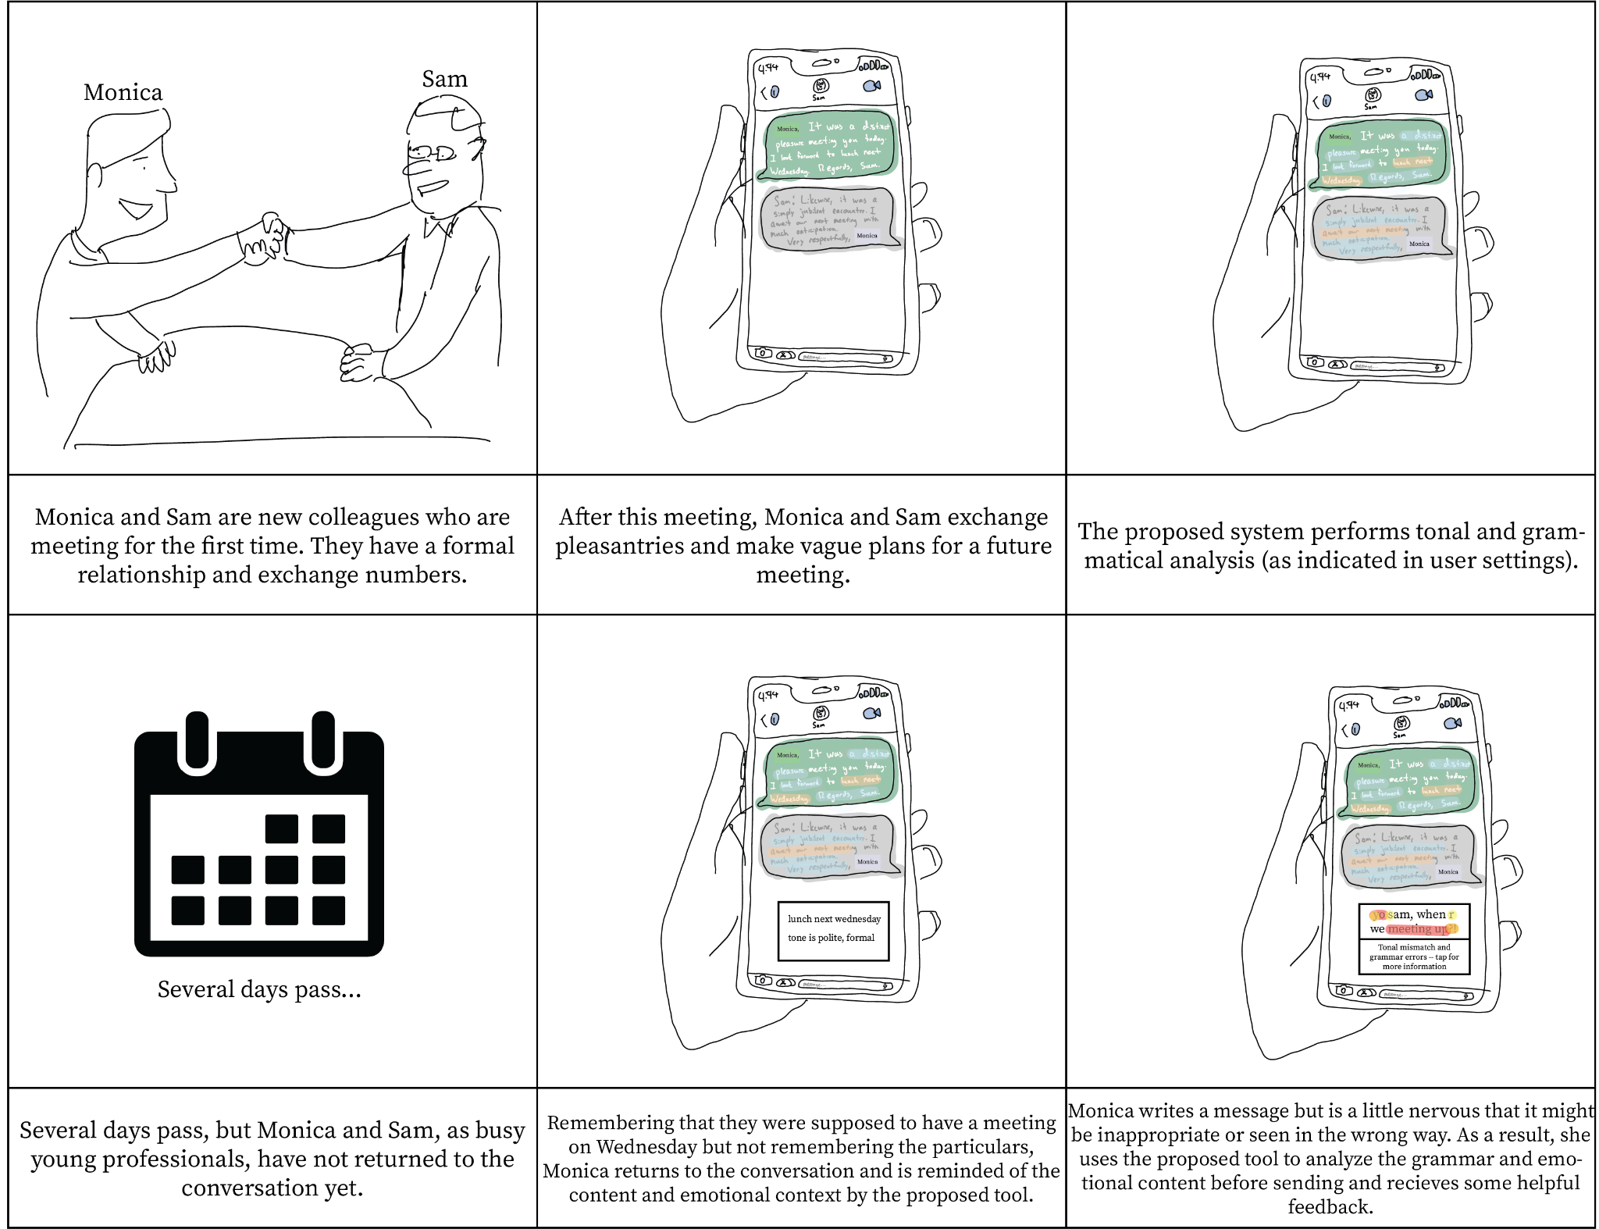
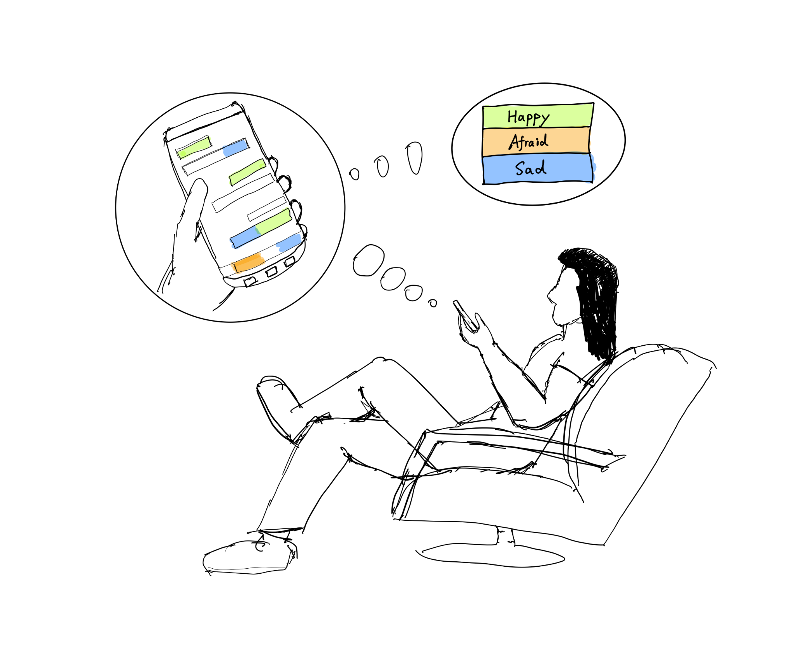
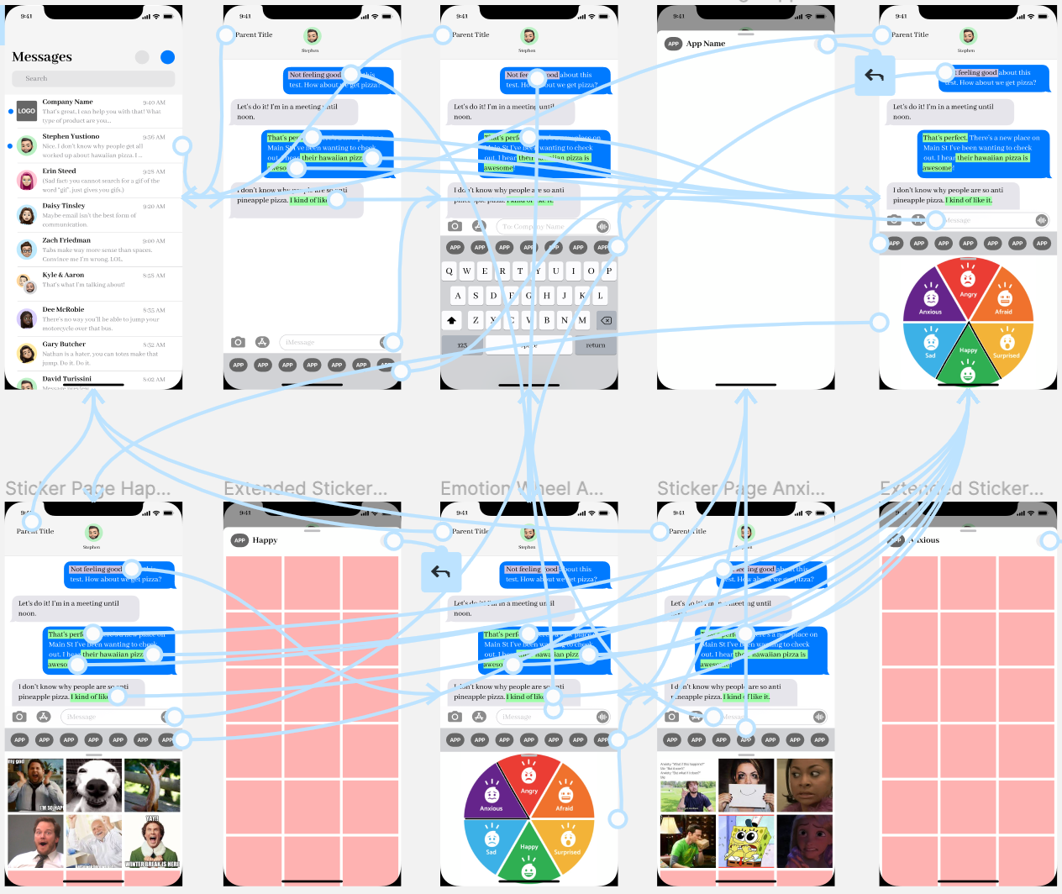
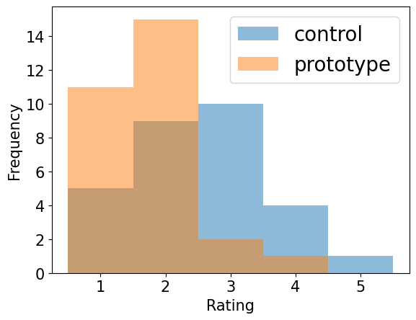
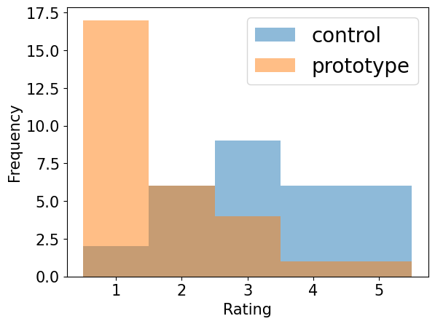
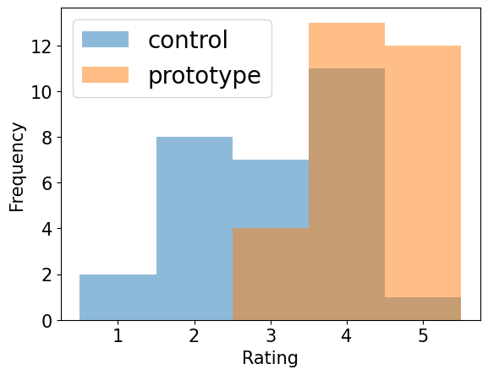
An Exploration of Emotional Miscommunication Intervention in Text Entry
Gregory Croisdale, Brent George, Ruei-Che Chang, Daniel Chechelnitsky, Zhenning Yang
{gregtc, bdgeorge, rueiche, dchechel, znyang}@umich.edu
Introduction
Design and Prototypes
User Evaluation
Abstract
Digital messaging with more accurate emotional communication can make our worldwide connectivity more authentic and less prone to misunderstandings
Textual communication places limitations on implicit messaging [1, 2], like tone and body language, when compared with face-to-face interaction
We present a series of studies and interviews of this topic, culminating in the design of a system that provides tools to understand the emotional context of a digital conversation
A user study indicates that this design makes a positive impact on the user experience
We ran a null-hypothesis test against our user requirements with a control (iMessage) and test (our design) variable. 29 users gave a Likert scale response (from 1 to 5) to the following 3 questions:
How difficult is it to identify the tone of the previous message?
How difficult is it to find a meme that suits the emotional context?
Overall satisfaction?
Null hypothesis: The designed interface does not have an impact on the user experience
Low-Fidelity Prototype Flowchart
Low Fidelity Prototype Storyboard
Results
We performed the Wilcoxon signed-rank test on our data with effect size=0.5 and alpha=0.05
P-values < alpha for all three questions, and therefore we reject the null-hypothesis
Sketch of End User in Environment
Context of Use
People rely on peers and themselves, not tech, to understand the emotional context of a message
The most frequent and the most severe misunderstandings are in non-professional contexts, such as text messaging
Initial User Testing
Users were overwhelmed by the density and encoding of colors
In response, highlighting was reduced and an emotion color wheel was implemented
Question | Control Mean | Prototype Mean | P-Value
1: Tone | 2.55 | 1.76 | 0.000295
2: Meme | 3.28 | 1.72 | 0.000149
3: Satisfaction | 3.03 | 4.28 | 0.000144
Takeaways & Future Work
User Requirements
High-Fidelity Prototype Flowchart
Our design shows the value of digital tools focused on the emotional context of a conversation, as well as the current lack of such tools in one popular messaging app. Future work may include:
A backend implementation that uses NLP to fully demonstrates our design
Integration with existing messaging services like iMessage, Discord, and Slack
Upon navigation to a conversation page, users need convenient access to information about the emotional context and content from the previous messages
After composing a message, users need preemptive feedback on the emotional tone of their draft message in the context of the previous conversation, prior to the message being sent
After drafting a message, users need additional ways to enhance the textual content of a message in order to deliver their intent unambiguously
User Evaluation Results
References
How difficult is it to identify the tone of the previous message? (1 easy - 5 difficult) | How difficult is it to find a meme that suits the emotional context? (1 easy - 5 difficult) | Overall satisfaction? (1 least - 5 most)
[1] Lynne Kelly and Aimee E. Miller-Ott. 2018. Perceived Miscommunication in Friends’ and Romantic Partners’ Texted Conversations. Southern Communication Journal 83, 4 (Aug 2018), 267–280
[2] Albert Mehrabian and Susan R. Ferris. 1967. Inference of Attitudes from Nonverbal Communication in Two Channels. Journal of Consulting Psychology 31, 3 (1967), 248–252
Notes:
‹#›

